Slide 1
Emergency Device Management System
Presentation

Slide 2
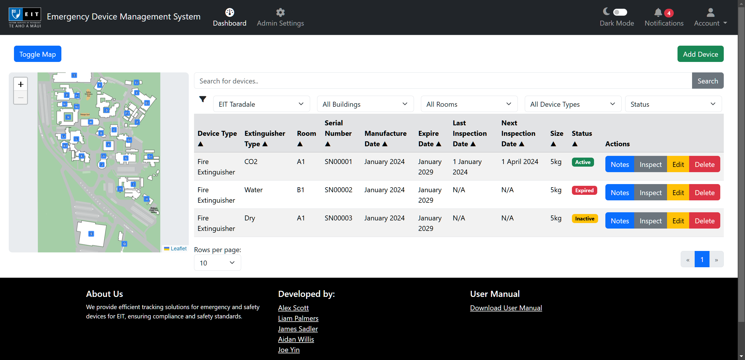
Application Overview
This web app helps manage and track emergency devices, primarily fire extinguishers, across campuses. It is cross-platform and accessible from any device with a web browser.

Slide 3
Application Features
Key Features:
Authentication: Create an account, log in, and reset your password.
Manage Devices: View, add, edit, and delete devices.
Interactive and static site maps: View and interact with site maps.
Inspect Fire extinguishers: View, add, and edit inspections.
Filter Functionality: Filter devices by site, building, room, type, or status.
Search Functionality: Search for devices using the search box.
Role-Based Access: Admins manage devices; users have limited access.
Automated Alerts: Notifications for device expirations and maintenance.
Admin Controls: View, add, edit, and delete, users, sites, buildings, rooms, and device types.

Slide 4
Prototype 1 - Completed features
Admin Settings:
View All User Accounts
Update User Account details such as username, email, role, and password
Delete User Account
View All Sites
Add a Site with a site name, site address, and an optional site map image
Update a Site
Delete a Site
View all Device Types
Add a Device Type with a Device type name
Update a Device Type
Delete a Device Type
Authentication:
Create an account
Login
Forgot password
Dashboard:
View All Emergency Devices
Add an Emergency Device
Update an Emergency Device
Delete an Emergency Device
View Site Map
Filter by building using map
Filter by site using dropdown

Slide 5
Prototype 1 – Will do features
Manage Buildings:
View all buildings
Add a new building to a site
Update a building
Delete a building
Manage Rooms:
View all rooms
Add a new room to a building
Update a room
Delete a room

Slide 6
Prototype 2 – Planned features
Dashboard:
Filter devices by building
Filter devices by room
Filter devices by Device Type
Filter devices by Status
Sort devices by their properties in ascending or descending order.
Inspection:
Add a Fire extinguisher inspection
Update a Fire extinguisher inspection
View All inspections for a Fire extinguisher
Notifications:
View all device inspection and expiry notifications
Clear notifications

Slide 7
Project Status
Prototype 1 release: 06/10/24 – Complete (certain features in progress)
Prototype 2 release: 27/10/24 – In Development
Final Application release: 10/11/24 – Not started

Slide 8
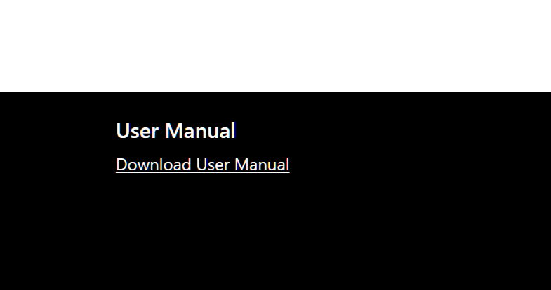
User Guide Development Plan
We'll create a PDF that outlines the app's features, usage instructions, and installation steps.
A link to view and download the PDF will be provided in the app's footer

Slide 9
Deployment Plan
The app will be deployed either on-premise or in the cloud, based on client preference.
Additional testing and consultation are required for on-premise hosting.
Cloud hosting may involve ongoing costs.
Free cloud hosting providers may have usage limits.
Further research and consultation is needed to determine the optimal hosting solution.

Slide 10
Prototype 1 Live Demo

